Slide 1
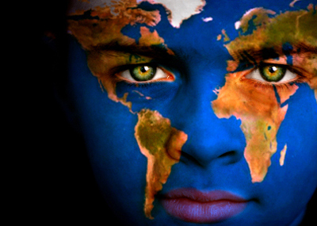
How to study geography
Objectives:
Use latitude & longitude
Identify different maps

Slide 2


What is geography?
Geography is
The study of EVERYTHING on Earth
Landforms, people, climates, cultures, etc.
Goal is to better understand:
How the Earth is changing
How humans influence the environment and vice versa

Slide 3
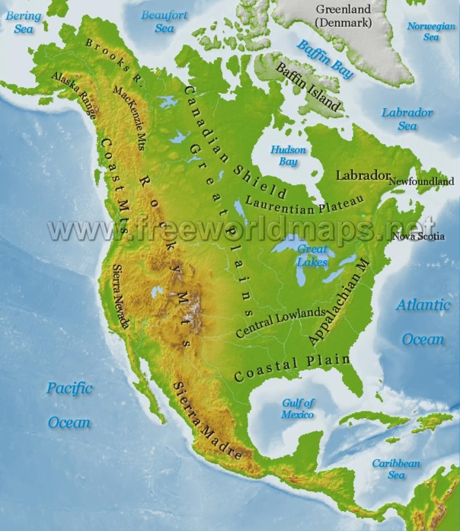
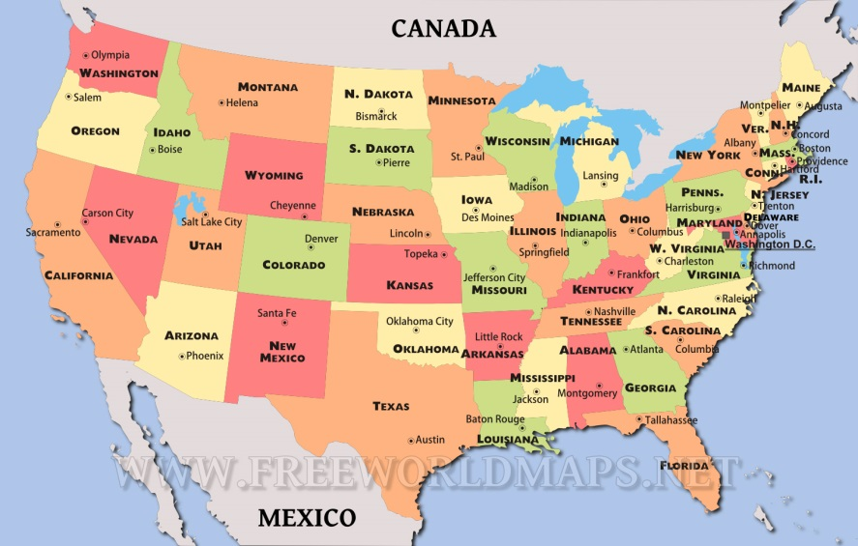
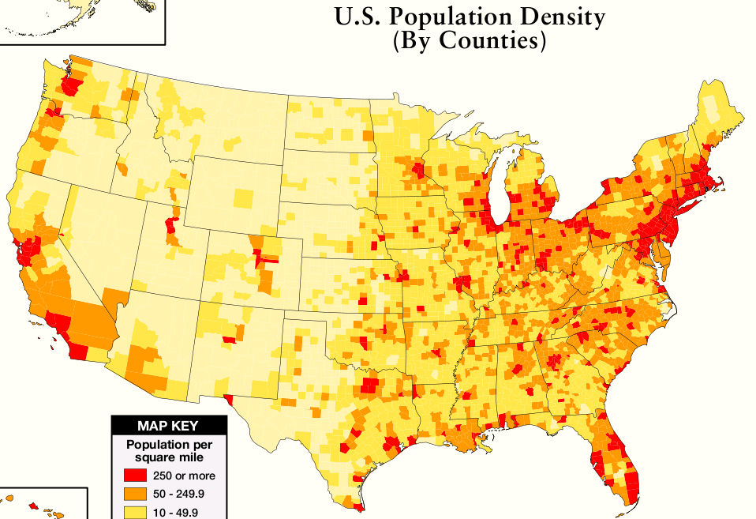
Using geographer’s tools
Different Types of Maps:
Physical Maps
Show natural features of the land
Political Maps
Show political boundaries (borders between countries/states)
Thematic Maps
Focus on a specific element of the place
Ex: Climate, population, resources, etc.

Slide 4
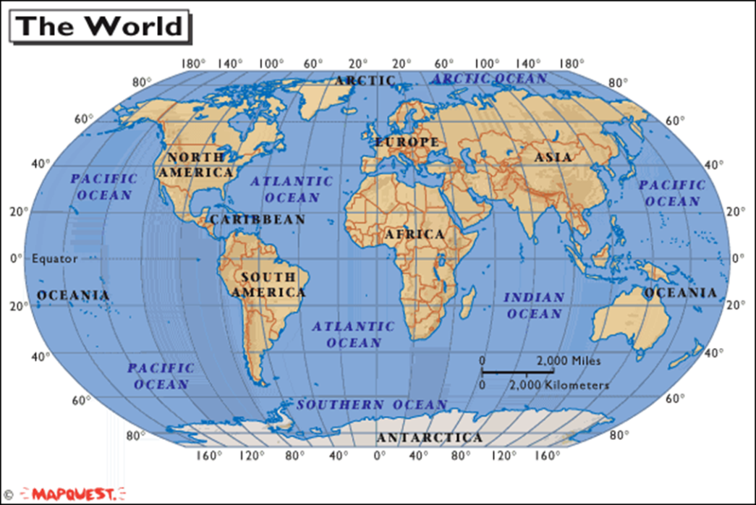

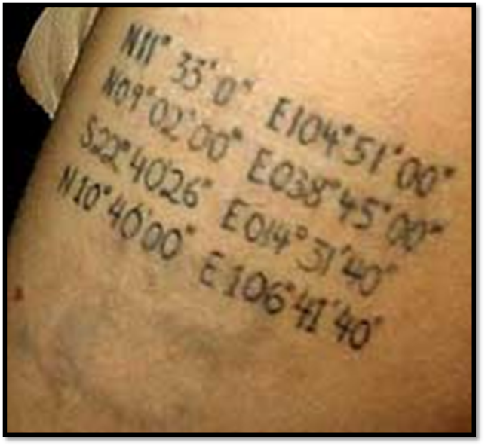
Using Geographer’s tools
Latitude and Longitude
Any place on earth can be found using coordinates (intersection of latitude and longitude)
L & L are measured in degrees
Degrees are about 70 miles apart
Minutes are the units in between degrees

Slide 5
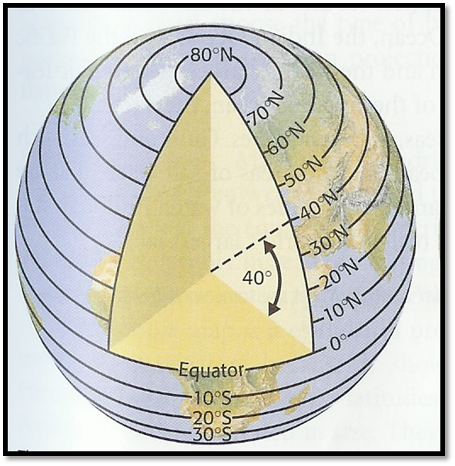
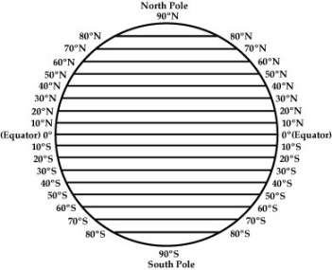
Latitude
Lines that run ACROSS the globe
Measure distances north and south of the Equator
The equator is the 0° line of latitude
Lines of latitude run from 0° to 90°

Slide 6
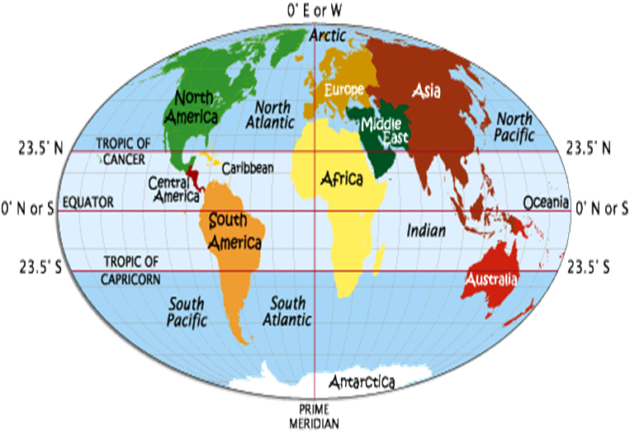
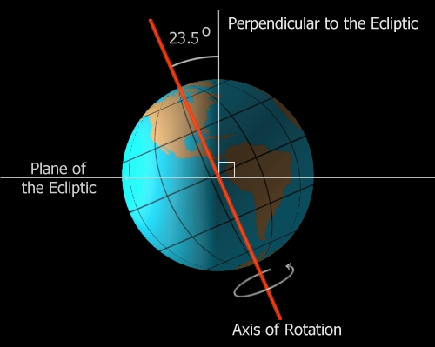
Latitude
Two lines of latitude that are very important
Tropics – places on the earth that receive the most heat from the sun.
The Tropic of Cancer at 23½˚ N
The Tropic of Capricorn at 23½˚S

Slide 7
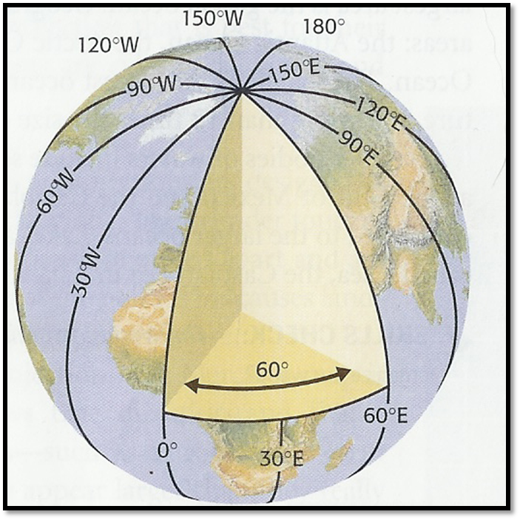
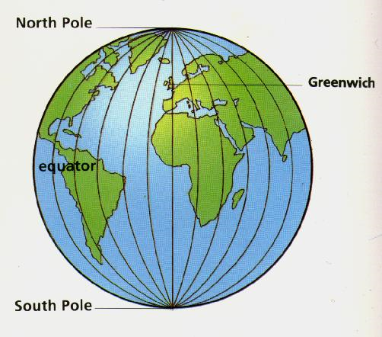
Longitude
-Lines of longitude are drawn up and down
-Measure places east and west of the Prime Meridian (0° longitude).
Prime Meridian runs through Greenwich, England
Lines of longitude run from 0° to 180°

Slide 8
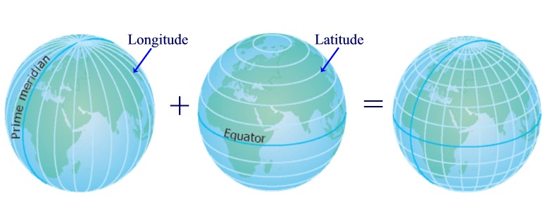
Writing Latitude & Longitude
Latitude will always have either North or South written before the degree
Longitude will always have either East or West before the degree
Latitude is always written first, then Longitude

Slide 9

Practice
Turn to page S27-S28
What state is found at 45°N , 70°W?
What state is found at 35$°$N, 77°W?
What city is found at 30°N, 90°W?
What are the coordinates for Trenton, NJ?
What are the coordinates for Salem, OR?

Slide 10
Board review
Brain Games

Slide 11

This measures areas north or south of the equator…
Longitude
Miles
Latitude
Tropics

Slide 12
The measurements of latitude and longitude are always measured in
Angles
Coordinates
Degrees
Inches

Slide 13
What is the hottest place on Earth due to direct sunlight?
Tropics
Prime Meridian
California
South

Slide 14
The coordinate 110° can only be describing…
The Western Hemisphere
Longitude
The Eastern Hemisphere
Latitude

Slide 15
What is the line of 0° longitude called?
Equator
Parallel
Capricorn
Prime Meridian

